Slide 1
Maritime Data Intelligence System - Predicting the revenue of Ship Chartering Business
By Rucha Joshi

Slide 2
Agenda
Problem Overview
Data Set Overview
Data Wrangling
Exploratory Data Analysis
Model Selection and Results
Conclusion
Recommendations

Slide 3
Problem Overview

Slide 4
Shipping has been key in facilitating trade and globalization. It is one of the largest industry in the world.
This sector handles roughly 60% of the value and 75% of the tonnage of world trade according to Lloyd’s MIU.
Shipping industry is very competitive, in addition to competing with each other, they must fight with all four modes of freight transportation: air, rail, water and road. Recently these conscious shippers are getting more aware of all the costs by analyzing their history data to make more precise decisions.
Prediction of the revenue on the particular charter by creating a machine learning model based on the previous year’s available data will help the shipper to choose best trades to get the maximum profit.
Our goal in this project is to help shipowners to choose the charter wisely to maximize their profits by identifying the cost affecting factors on the voyage.
We built the model that can explain which factors have predictive power.

Slide 5
Data Set Overview

Slide 6
The dataset includes about 185,000 observations which has voyages from 2009 across the world. The other datasets are Port details, Vessel details and Voyage details.
The data includes following important fields -
1. Voyage Id - Id assigned to each voyage
2. Vessel Id - Id assigned to each vessel
3. Commencing Date - Start date for the voyage
4. Completing Date - End date for the voyage
5. Vessel types - There are total 12 different types of vessels.
6. Vessel description - Is vessel a Tanker or a Bulk
7. Cargo types- There are 20 unique values of cargo types.
8. First load port - This is the port where first vessel got loaded.
9. Last discharge port - This is the last discharge port for the voyage. There can be multiple discharge ports for single voyage.

Slide 7
10. Cargo type - It gives information about what type of cargo vessel is carrying.
11. Cargo lift - It tells us how much cargo the vessel is carrying.
12. Dwt - Deadweight tonnage of the ship.
13. Estimated earnings and Actual Earnings
14. Trade Area - The area where the voyage is travelling.
15. Estimated voyage days and Actual voyage days
16. Ballast days - when vessel is empty
17. Laden days - when vessel is loaded
18. Base Currency - Currency of earnings
19. Operators details
20. Laden and Ballast Speed - this is finalized at the charter party.
21. Vessel properties such as built year, owner etc.
And there are few more fields for internal use of the shippers which are not relevant to our analysis.

Slide 8
Data Wrangling
Data cleaning and reformatting

Slide 9
Data Loading
Missing Value Replacement
Handling Outliers
Reformatting

Slide 10
Exploratory Data Analysis
Which variables appear to have predictive power?

Slide 11
Top Trade Areas
These are the top trade areas with respect to sum of earnings.

Slide 12
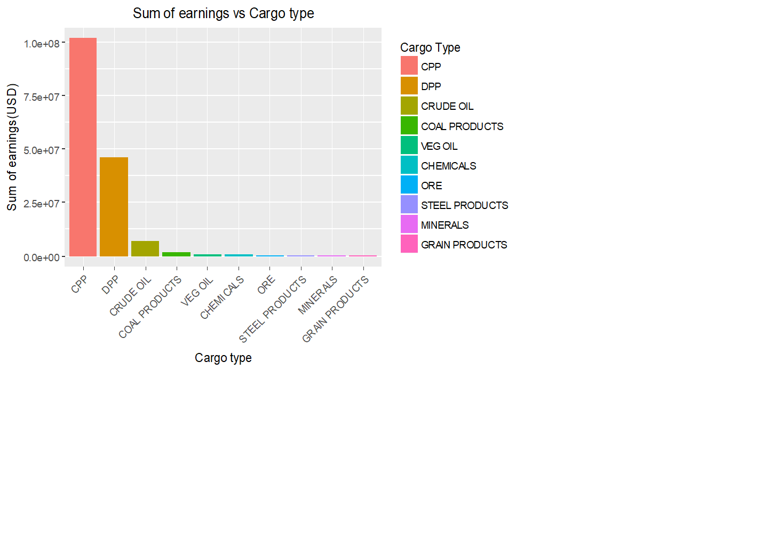
Top Cargo types
This graph shows that CPP, DPP and Crude Oil are major contributors in the high earnings.

Slide 13
Model Selection and Results

Slide 14
Model Workflow
Tuning Model Parameters
Data Wrangling
Data Partition
Training Data
Build Model
Training Results
Data
Test Data
Trained Model
Test Results

Slide 15
As the data is supervised data we first tried to fit Linear Regression model to predict the earnings of a voyage.
We used forward selection approach in building the linear regression model, which starts with no predictors in the model, iteratively adds the most contributive predictors, and stops when the improvement is no longer statistically significant

Slide 16
After the third iteration of the model we get the list of variables which are statistically significant with the
Multiple R-squared: 0.1517
Adjusted R-squared: 0.1443
p-value: < 2.2e -16

Slide 17
Conclusion

Slide 18
Most important variables with which Earnings can be predicted are vessel type, loading and discharge ports, cargo type, deadweight tonnage and cargo lift.

Slide 19
Recommendations

Slide 20
Including weather data for each voyage for further analysis will be helpful to get more precise predictions as it is directly related to fuel consumptions.
To improve the accuracy in the prediction we can try using different algorithms like Random Forest or Extreme Gradient Boosting.
Comparison of competitor’s business can provide more ideas to improve the business.

